Slide 1
Design Digitaler Schaltkreise
Synthesis and Timing Analysis Basics
Prof. Ivan Peric ivan.peric@kit.edu
Richard Leys richard.leys@kit.edu
Ilias: https://ilias.studium.kit.edu/goto_produktiv_crs_430424.html

Slide 2
Lecture Goal
Learn the basics of the Synthesis Steps
Get used to the required data used by synthesis
Sources, Timing Libraries etc..
Learn the Static Timing Analysis concept:
Semantic: Timing delay, slew, slack etc…
Understand setup and hold timing violations
See how timing reports look like
Learn the basics of timing constraints writing:
Clock domain
Input/Output constraining

Slide 3
Flow overview reminder
HDL
Final HDL: All logic design + IP are ready, I/Os are set
.v
.vhd
Synthesis
Gates
Design Data: Libraries, Timing Constraints etc..
LEF
LIB
SDC
DEF
Place and Route
Add “system” components: PLL, Extra cells like ESD clamps etc…

Slide 4
Generic Synthesis Flow Reference
Tool Setup
LEF
LIB
checks,reports
Load Libraries
checks,reports
.v
.vhd
Load Design
checks,reports
Elaborate
SDC
checks,reports
Load Timing Constraints
checks,reports
Synthesis
STA
DEF
Physical
Mapped
Timing reports
Incr. optimisation
checks,reports
Output
.v

Slide 5
Timing Library
library (uk65lscllmvbbr_090c125_wc) {
...
nom_process : 1.0 ;
nom_temperature : 125.0 ;
nom_voltage : 0.9 ;
operating_conditions(uk65lscllmvbbr_090c125_wc) {
process : 1.0;
temperature : 125.0;
voltage : 0.9;
tree_type : balanced_tree
}
...
cell(DFQBM1RA) {
area : 7.200000 ;
cell_footprint : DFQB ;
...
pin(QB) {
capacitance : 0.000000 ;
direction : output ;
...
timing() {
related_pin : "CK" ;
timing_type : rising_edge ;
cell_rise(...) {
}
rise_transition(...) {
}
...
}
...
}
...
}
Seen low level Flip-Flop and Cells in previous lecture
Timing Library specified for one corner:
Process Information: Voltage Temperature etc…
Speed Case: Slow, Typical, Fast
Timing Libraries provide characterisation of cells:
timing “arcs” between input/outputs
Ex: Q to CK
Wire loading models
Power
Pin Capacitance etc…
Format used in RTL compiler: Synopsis liberty

Slide 6
Timing Arcs: Delay and Slew
SLEW RATE
rise_transition(...) {
}
A
rise
fall
DELAY
cell_rise(...) {
}
B

Slide 7
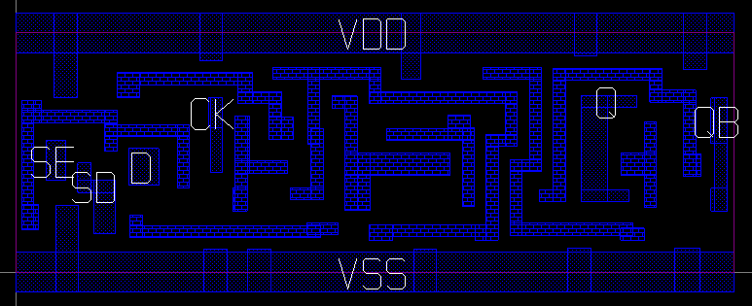
LEF (Library Exchange Format) File
LEF files contain physical information for Cells
Technology rules and specs can be defined
Ex: Number of layers
Ex: VIA Definition
Cells physical information include:
Size
I/O (Pins) size and locations
Layer obstructions
Full layout is not included
LAYER VI1
TYPE CUT ;
SPACING 0.1 ;
SPACING 0.11
ADJACENTCUTS 3 WITHIN 0.14 ;
…
END VI1
ME1
ME2
Using GLADE LEF viewer
MACRO SDFQBRM1RA
CLASS CORE ;
SIZE 6.0000 BY 1.8000 ;
SYMMETRY X Y ;
SITE CORE ;
PIN CK
DIRECTION INPUT ;
PORT
LAYER ME1 ;
RECT 1.4400 0.4900 1.5500 0.8900 ;
END
END CK
ENDMACRO

Slide 8
DEF File
Design Exchange Format
Contains Design Data put together:
Floorplaning info
Netlist etc…
Used by Synthesis to load floorplaning information
Synthesis
DEF
Physical
Floorplan: Size and block, io placements

Slide 9
Synthesis Ready HDL: Top Level
Two types of Top Level HDL
Partition Module: Just I/O which are pins
Final Top Level: add instances of real I/O Cells
Partition: Just pins
Top: With IO Cells
Io cell
1 module xxx (
2
3 input a,
4
5 );
6
7 wire a_internal;
8
9 IUMA a_io(.PAD(a),.DI(a_internal));
10
11
12 mymodule mymodule_I (
13
14 .anotherinput(a_internal)
15 );
16
17 endmodule
Core/internal
IO

Slide 10
Top Level HDL: IP Blocks (RAM example)
All special components acting in the logic design must be instantiated
Use Provided Verilog, Timing and LEF from Provider
Standard example: RAMS
In FPGA, a RAM is an array, mapped by the tool
In ASIC,the RAM is instantiated
Example in UMC65:
1 module SJKA65_512X32X1CM4 (DOA0,DOA1,DOA2,DOA3,DOA4,DOA5,DOA6,DOA7,DOA8,
2 DOA9,DOA10,DOA11,DOA12,DOA13,DOA14,DOA15,
3 DOA16,DOA17,DOA18,DOA19,DOA20,DOA21,DOA22,
4 DOA23,DOA24,DOA25,DOA26,DOA27,DOA28,DOA29,
5 DOA30,DOA31,DOB0,DOB1,DOB2,DOB3,DOB4,
6 DOB5,DOB6,DOB7,DOB8,DOB9,DOB10,DOB11,DOB12,
7 DOB13,DOB14,DOB15,DOB16,DOB17,DOB18,DOB19,
8 DOB20,DOB21,DOB22,DOB23,DOB24,DOB25,DOB26,
9 DOB27,DOB28,DOB29,DOB30,DOB31,A0,A1,
10 A2,A3,A4,A5,A6,A7,A8,B0,B1,B2,B3,B4,B5,B6,B7,B8,
11 DIA0,DIA1,DIA2,DIA3,DIA4,DIA5,DIA6,DIA7,DIA8,
12 DIA9,DIA10,DIA11,DIA12,DIA13,DIA14,DIA15,
13 DIA16,DIA17,DIA18,DIA19,DIA20,DIA21,DIA22,
14 DIA23,DIA24,DIA25,DIA26,DIA27,DIA28,DIA29,
15 DIA30,DIA31,DIB0,DIB1,DIB2,DIB3,DIB4,
16 DIB5,DIB6,DIB7,DIB8,DIB9,DIB10,DIB11,DIB12,
17 DIB13,DIB14,DIB15,DIB16,DIB17,DIB18,DIB19,
18 DIB20,DIB21,DIB22,DIB23,DIB24,DIB25,DIB26,
19 DIB27,DIB28,DIB29,DIB30,DIB31,WEAN,WEBN,CSAN,
20 CSBN,CKA,DVSE,DVS0,DVS1,DVS2,DVS3,
21 CKB);
.v
DO[31:0]
LEF
512 x 32
entries
entry size

Slide 11
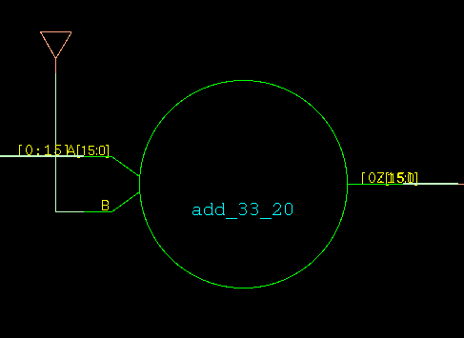
Elaboration
Parses and compiles the design to an internal logic representation
Basically the same as in any other tool:
Simulation: irun runs “ncelab”
Check the elaborate output for errors and warnings:
Unsupported syntax
Connection width mismatches etc..
Example from counter:
Tie-high
value <= value + 1

Slide 12
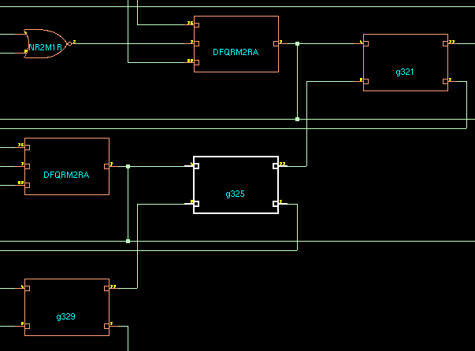
Synthesis: Principle
Two kinds of operations:
Boolean logic (& , ! , ^ …)
Arithmetic operators (+,- etc…)
Principle:
Minimize Boolean logic network
Map logic and arithmetic to gates and tries to match costs functions:
Area
Power
Timing
Main Focus to be chosen:
Power ? Area ? Timing?
Usually: Meet timing for performance
ADHM1RA
Sum and Carry out

Slide 13
Synthesis: Clock Gating example
Clock gating is a good example of synthesis optimisation
It can help save power and modifies timing
Concept:
If a register value changes when an enable signal is asserted, then remove the clock when not changing
change
val
MUX
val
change
No clock gating
Clock Gating

Slide 14
STA: Overview
Gate Level + Timing Constraints enable timing the design
Synthesis tries to fix timing during incremental optimisation
Important: Synthesis happens during early implementation stage. Its accuracy is not great.
Two kinds of checks are performed:
Setup: Make sure logic is not too slow (slow corner)
Hold: Make sure logic is not too fast (fast corner)
Timing Setup for synthesis: Worst case to ensure it will always work
Elaborate
Synthesis
synthesize –to_mapped
STA
Gate netlist
write_hdl > netlist.v
.v
Incr. optimisation
synthesize –to_mapped -incr

Slide 15
STA: Setup
&
&
Tgate
Trc
Tgate
Tcomb
Launch!
Capture!
Tco
Clock to output
Trc
Interconnect
Tcomb
Logic
Trc
Interconnect
TSetup
FIX: Make faster
Total
+
Positive slack
-
Negative slack
Total

Slide 16
STA: Hold
Data must remain stable for Thold after clock period: Cannot be too fast
Thold
FIX: Make Slower
Total
Total
Positive slack: Slow enough
+
Total
-
Negative slack: Too Fast

Slide 17
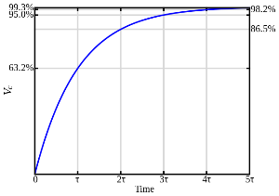
STA: Timing Parameters
Mostly two types of delays:
Gate delays: Input to Output, Clock to output
Interconnect Delay (RC extraction)
RC extraction is called parasitics extraction:
R for wire resistance
C for interconnect capacitance
Cross-Talking can be extracted (can make RC faster)
Cross-talk
&
&
R
C
Tgate
Trc
Tgate

Slide 18
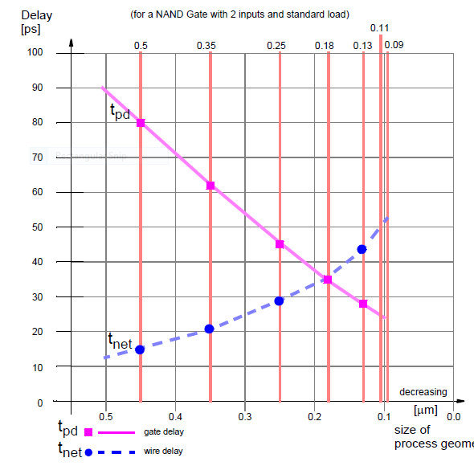
STA: Physical Synthesis for wire delays
RC Extraction was done in the past using statistical models
Estimation of wire length was done based on area and fanout
Starting at ~0.18µ, wire delays become too dominant, so wire delay extraction is required during synthesis -> physical synthesis
DEF
Synthesis
Physical
STA
Incr. optimisation
Fast Place and route
Extraction

Slide 19
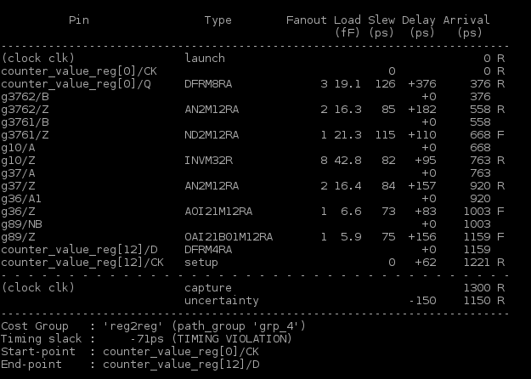
STA: Setup Timing Report example
List of Gates, interconnect and associated timing delay
Sum at the end and check against allowed clock period
Tco
Clock to output
Trc
Interconnect
Tcomb
Trc
Interconnect
TSetup
Tgate
Trc
Tgate
Launch!
register
Tco
Type:
Empty for Trc, Gate name otherwise
Trc
Tgate
.
.
.
register
TSetup
Capture!
Slack = (capture - uncertainty) - arrival -71ps = (1300 - 150) - 1221

Slide 20
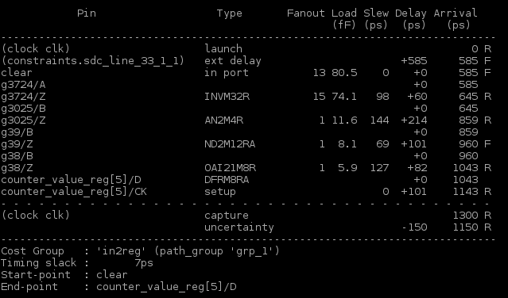
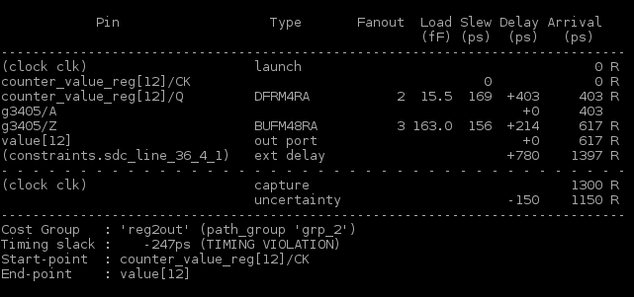
STA: Timing report types
Previous Slide: Register to Register
Other general Timing paths: Register to Output, Input to register, Input to Output
input
register
output
register

Slide 21
Timing Constraints
Specification for the clocks and paths to be timed
Format in RTL Compiler: Standard Design Constraints (SDC)
The timing analysis uses the constraints to perform analysis
Check Tool documentation
Path constraint
SDC
i/o constraint
create_clock -name clk -period 1.3 [get_port clk] #750Mhz
set_clock_uncertainty 150 -setup clk # Spare time on setup
set_clock_uncertainty 50 -hold clk # Spare time on hold
set_input_delay -clock clk 50 ...
set_output_delay -clock clk 100 ..
set_load -pin_load 0.15 [all_outputs] #15pf load on outputs
i/o constraint
clock

Slide 22
TC: Clock Definition
Specification:
Name of the clock
Period/Waveform
Start point: Typically the top level input (called port)
Uncertainty: Simply Overconstraining to cover unknown wire delay and physical placement information
Will be reduced the closer the design gets to its final stage, extraction takes over then.
The named created clock is called a Clock Domain
Later in Place and route: A Clock tree will be created
1 module top (
2
3 input wire clk
4 );
5
6 ....
7
8 endmodule
Name is arbitrary
In ns per default
clk port
create_clock -name clk -period 1.3 [get_port clk]
set_clock_uncertainty 150 -setup clk set_clock_uncertainty 50 -hold clk
Just remove time from period

Slide 23
Multi-Mode Multi Corner
The may be different constraints, like clock period depending on the mode of operation:
Test Mode: Clock fed trough a different “slow” input, main clock not active
Run Mode: Only main clock active
One cannot create two clock domains driving the same logic
Create two modes, which are analysed separately
Corners: Temperature and Voltage combinations
Synthesis: Only check modes
Place and route: perform extraction and analysis on all corners and modes
nT x nV x nM = many corners
Limit to the relevants: will my ASIC be in a -40° environment?

Slide 24
I/O constraints
Input and Output Delay for the outside world
Input: When does the input arrive after the clock (setup time from unknown)
Output:
How Much time is to be spared for the outside
How much capacitance do we have to drive
Example from counter:
hold
overflow
set_input_delay
set_output_delay
set_load -pin_load

Slide 25
False Paths: Non timed wires
Some Special Paths can be ignored
Configuration Lines if asserted during total inactivity (like reset)
Asynchronous Reset: Reset usually asserted for a long time, so don’t need to be timed
Wires not relevant to the mode of operation
1 always @(posedge clk or posedge res_n) begin
2 if (rst) begin
3 // reset
4
5 end
6 else begin
7
8 end
9 end
set_false_path -through [get_port res_n]

Slide 26
Multi Cycle: timing relaxing
Some paths can take more time, like configuration Lines barely changing, or changing when design is inactive anyway
They have to be timed anyways to respect setup and hold time
set_multicycle_path time -setup -through net
N cycles

Slide 27
Multiple Clock domains
Multiple Clocks can be defined in a design, there are then multiple clock domains
Some clocks are derived from each other, like divided clock
-> Generated Clocks
Timing is respected between the clock domains
Separated clocks are uncorrelated, thus false paths are set between flip flops of different clock domains
Design should prevent metastability
create_generated_clock -divide_by 4 \
–name clk_div_4 –from clk
clk
/ 4
clk_div_4
clk1
clk2

Slide 28
Results
Reports: Final timing and other kind of useful information
Gate Level Netlist
Use to re-simulate the design
Go to place and route
LEC tools check netlists for equivalence after each transformation:
After each synthesis step and incremental optimisation
Place and route setup
Some scripts to start with encounter
In real designs, not used in the end but still works for us
Reports

Slide 29
End Slide

